Slide 1

How to Prepare an Effective PowerPoint Presentation

Slide 2
Topics to be Covered
Outline
Slide Structure
Fonts
Color
Background
Graphs
Spelling and Grammar
Conclusions
Questions

Slide 3

1. Outline
Make your 1st or 2nd slide an outline of your presentation
Ex: previous slide
Follow the order of your outline for the rest of the presentation
Only place main points on the outline slide
Ex: Use the titles of each slide as main points

Slide 4
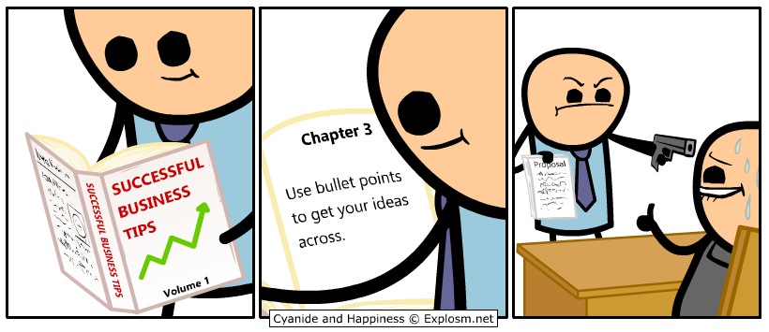
2. Slide Structure – Good
Use 1-2 slides per minute of your presentation
Write in point form, not complete sentences
Include 4-5 points per slide
Avoid wordiness: use key words and phrases

Slide 5
2. Slide Structure - Bad
This page contains too many words for a presentation slide. It is not written in point form, making it difficult both for your audience to read and for you to present each point. Although there are exactly the same number of points on this slide as the previous slide, it looks much more complicated. In short, your audience will spend too much time trying to read this paragraph instead of listening to you.

Slide 6

2. Slide Structure – Good
Show one point at a time:
Will help audience concentrate on what you are saying
Will prevent audience from reading ahead
Will help you keep your presentation focused

Slide 7
2. Slide Structure - Bad
Do not use distracting animation
Do not go overboard with the animation
Be consistent with the animation that you use

Slide 8
3. Fonts - Good
Use at least an 18-point font
Use different size fonts for main points and secondary points
this font is 24-point, the main point font is 28-point, and the title font is 36-point
Use a standard fonts like:
Times
New Roman
Arial

Slide 9
3. Fonts - Bad
If you use a small font, your audience won’t be able to read what you have written
CAPITALIZE ONLY WHEN NECESSARY. IT IS DIFFICULT TO READ
Don’t use a complicated font

Slide 10

4. Color - Good
Use a color of font that contrasts sharply with the background
Ex: blue font on white background
Use color to reinforce the logic of your structure
Ex: light blue title and dark blue text
Use color to emphasize a point
But only use this occasionally

Slide 11
4. Colour - Bad
Using a font colour that does not contrast with the background colour is hard to read
Using colour for decoration is distracting and annoying.
Using a different colour for each point is unnecessary
Using a different colour for secondary points is also unnecessary
Trying to be creative can also be bad

Slide 12
5. Background - Good
Use backgrounds such as this one that are attractive but simple
Use backgrounds which are light
Use the same background consistently throughout your presentation

Slide 13

5. Background – Bad
Avoid backgrounds that are distracting or difficult to read from
Always be consistent with the background that you use

Slide 14
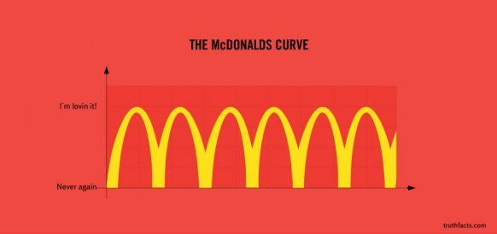
6. Graphs - Good
Use graphs rather than just charts and words
Data in graphs is easier to comprehend & retain
Trends are easier to visualize in graph form
Always title your graphs

Slide 15
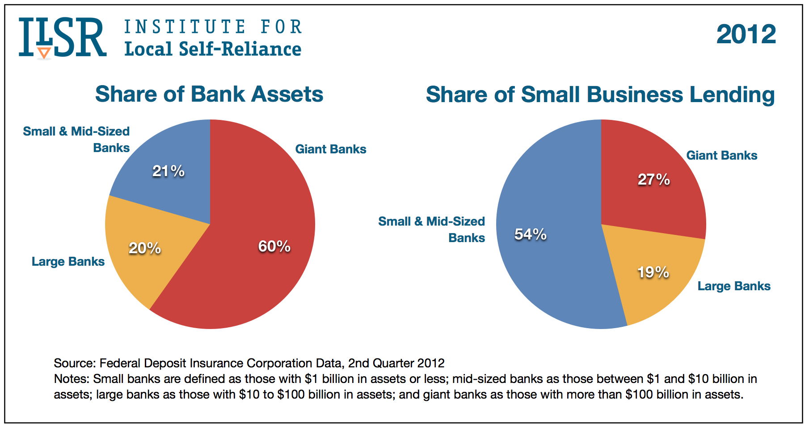

Slide 16
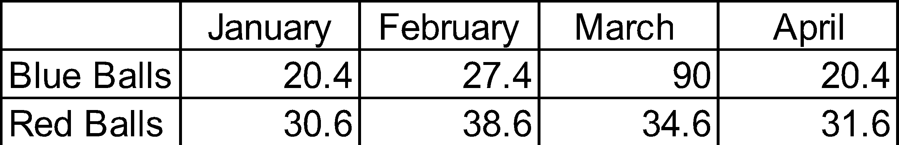
6. Graphs - Bad

Slide 17
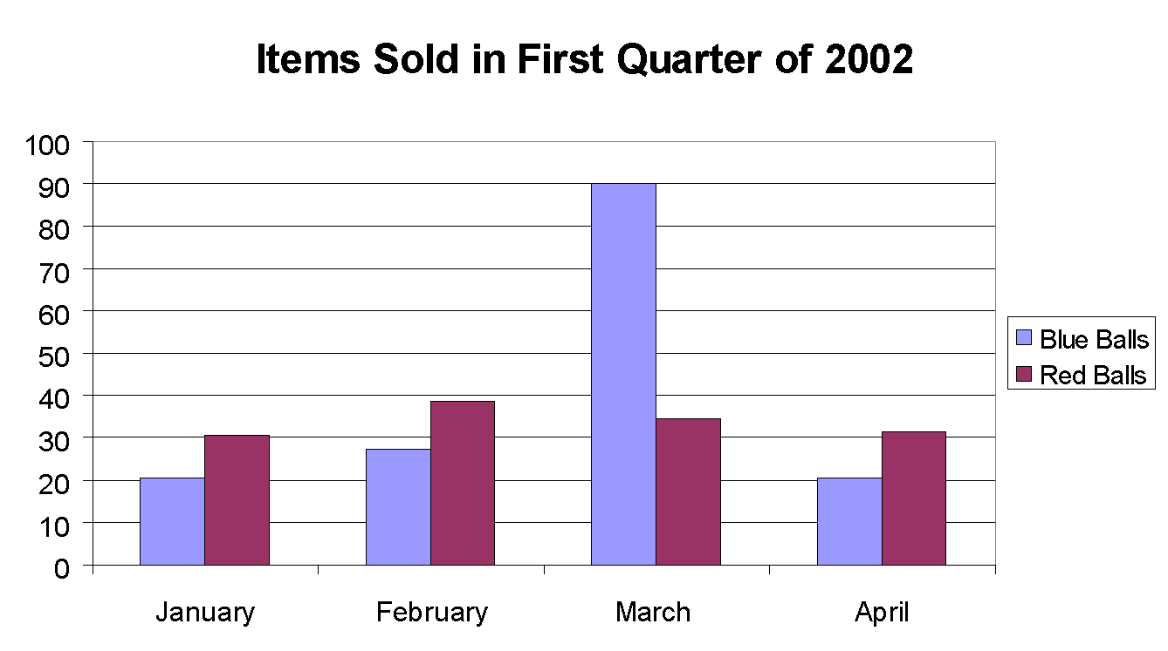

6. Graphs - Good

Slide 18
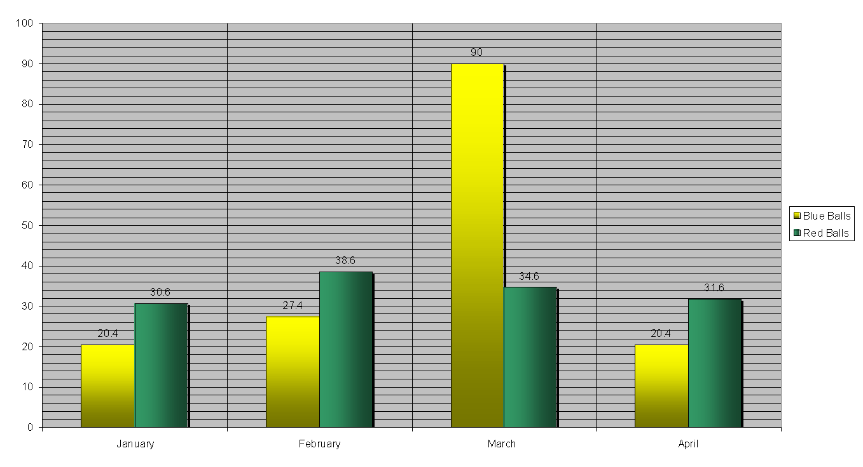
6. Graphs - Bad

Slide 19

6. Graphs - Bad
Minor gridlines are unnecessary
Font is too small
Colors are illogical
Title is missing
Shading is distracting

Slide 20

7. Spelling and Grammar
Proof your slides for:
speling mistakes
the use of of repeated words
grammatical errors you might have make
Ask someone to check your presentation!

Slide 21

8. Conclusion
Use an effective and strong closing
Your audience is likely to remember your last words
Use a conclusion slide to:
Summarize the main points of your presentation
Suggest questions for future research

Slide 22

9. Questions??
End your presentation with a simple question.
Invite your audience to ask questions
Provide a visual aid during question period
Avoid ending a presentation abruptly
THANK YOU!!

Slide 23
